Slide 1
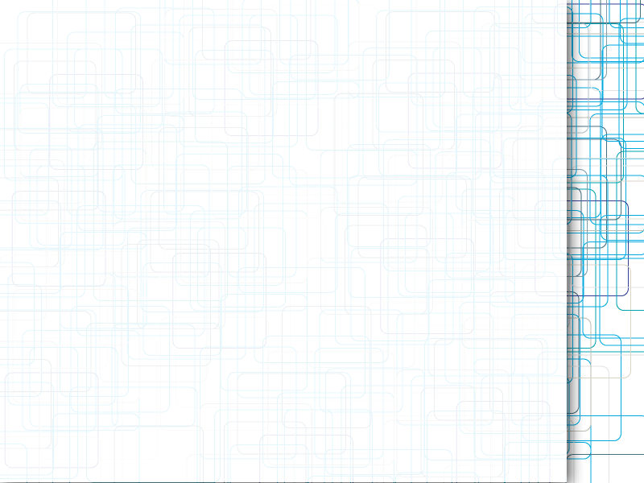
CalPlug EMS
Shivam Patel
Progress Update
5/16/12

Slide 2
Current Tasks
Collecting Waveforms from various loads
Get FFT from current waveforms

Slide 3
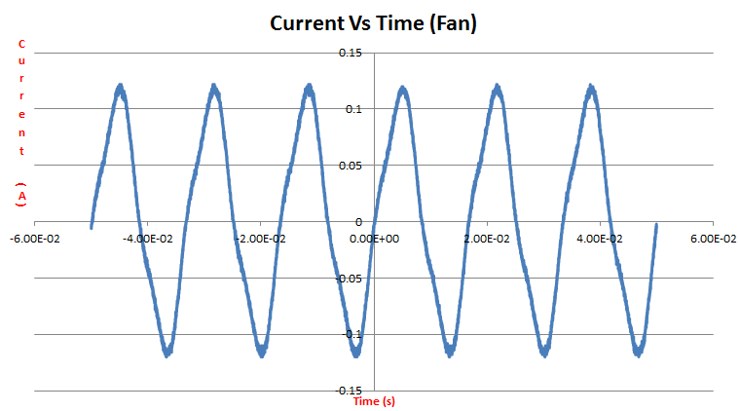
Fan

Slide 4
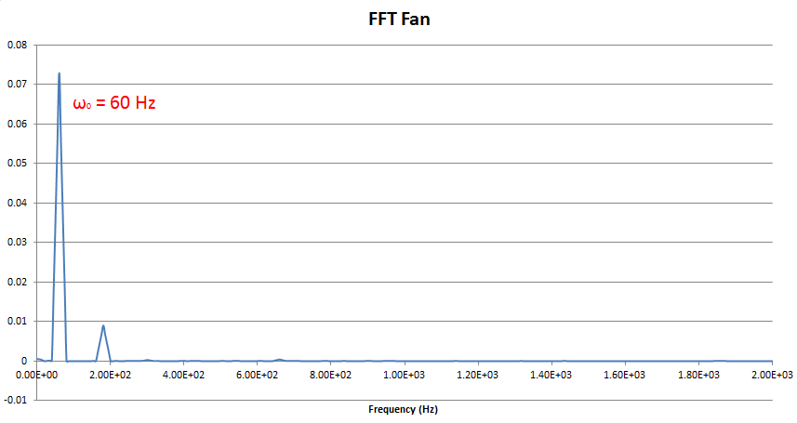
Fan

Slide 5
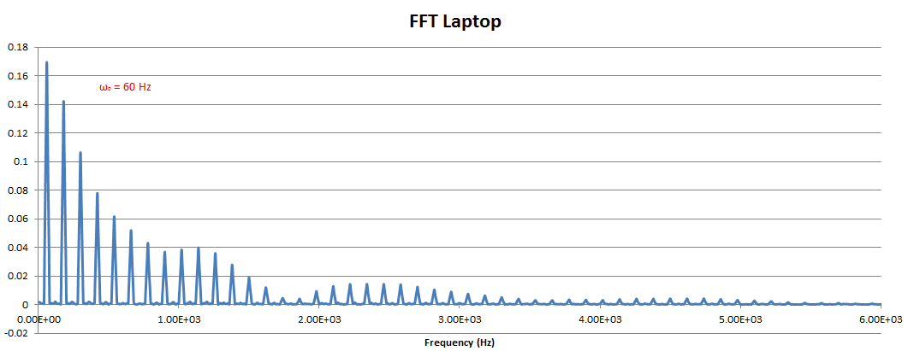
Laptop
What do we do with FFT?

